Slide 1

HEALTHCARE MANAGEMENT SYSTEM
Free PPT Templates
Insert the Sub Title of Your Presentation

Slide 2
Team Members (GB23)
Rhythm Dhingra
Shivam Kumar
Free PPT Templates
Insert the Sub Title of Your Presentation

Slide 3

INTRODUCTION
The HCMS is a Healthcare Management System Software designed to manage all aspects of a Healthcare operation. This customizable Healthcare management system is an integrated healthcare solution which includes Outpatient and Inpatient Management, Pharmacy, Laboratory, Radiology, Ward Management, Mobile Application, Online Appointments Scheduling, Secured Messaging, Doctor Portal, Patient and Family Portals, Medical Electronic Billing, Accounting, HR/Payroll and HL7/Integrated PACS System.
AWESOME

Slide 4



FEATURES :
Centralized Database system
User Friendly design
Complete database Driven
Modular Structure
Improve Visibility & Transparency
Streamline Accurate Reporting
Improved Quality Control
Improved Time Management
Improved Management Visibility
Unlimited User Support
Highly secured, user wise authentication of modules
Graphical Presentation of MIS.
Effective Search Facility to Search any type of Information related to Patient.
Multiple Store Accounting.
Connect multiple branches of Healthcares. Access patient record from anywhere
Remote accession of database for instant support
Interface facility with the Smart Card Technology.
Interface with the Bar Code.
Interface with Biometric Devices

Slide 5
MODULES
Admin:
Admin can add doctors, edit doctors, delete doctors
Schedule new doctor sessions, remove sessions
View patients details
View booking of patients
Doctors:
View their appointments.
View their scheduled sessions
View details of patients
Delete account
Edit account settings
Patients:
Make appointment online
Create account themselves
View their old booking
Delete account
Edit account settings

Slide 6

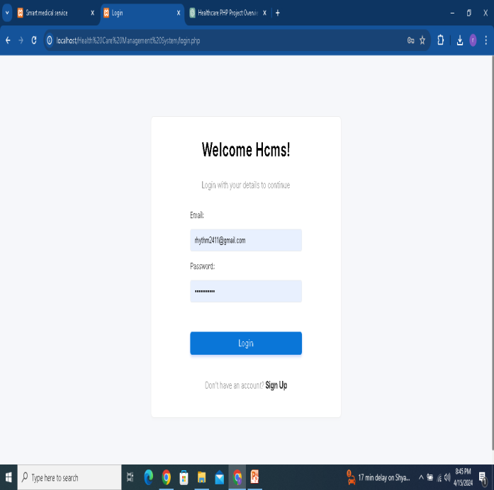
LOGIN

Slide 7
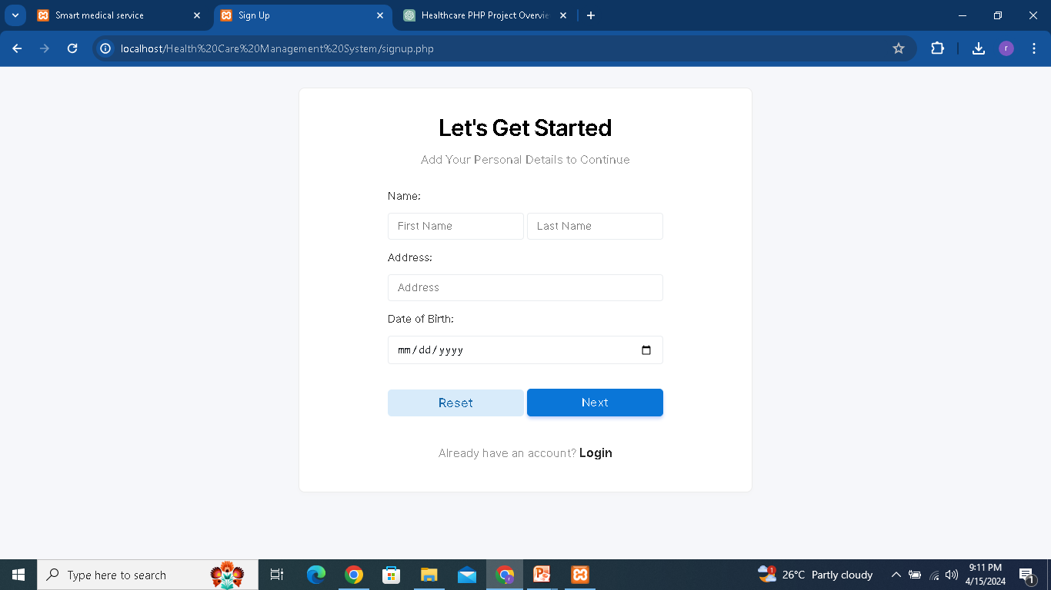
REGISTRATION

Slide 8
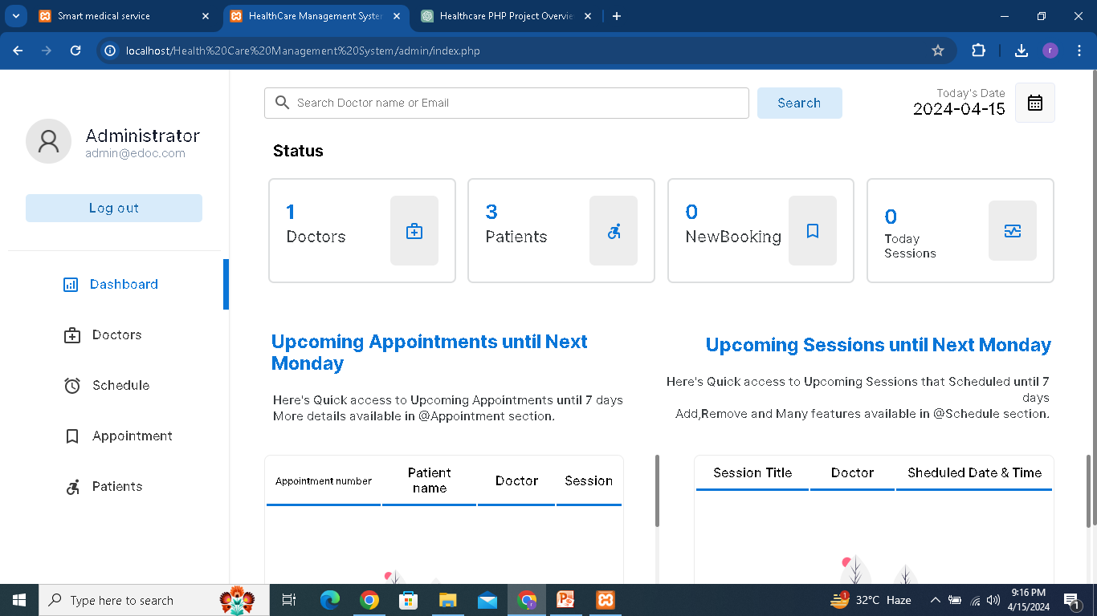
ADMIN DASHBOARD

Slide 9
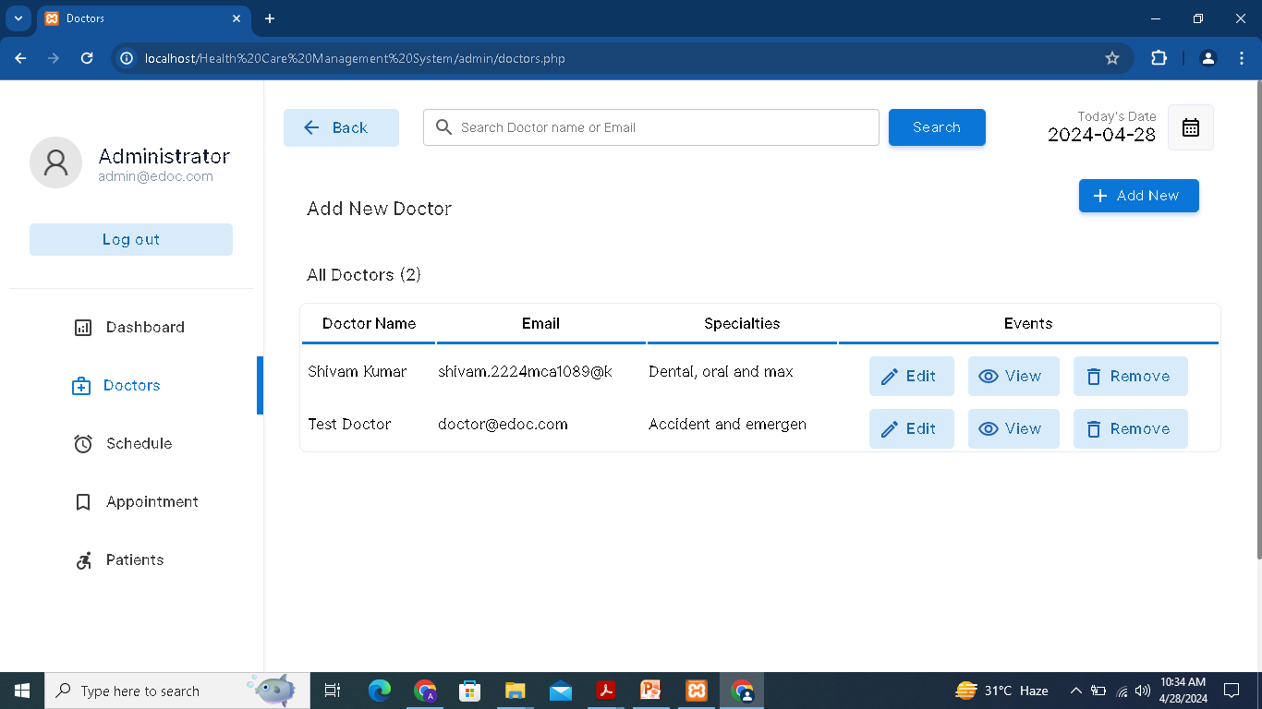
ADMIN DASHBOARD

Slide 10
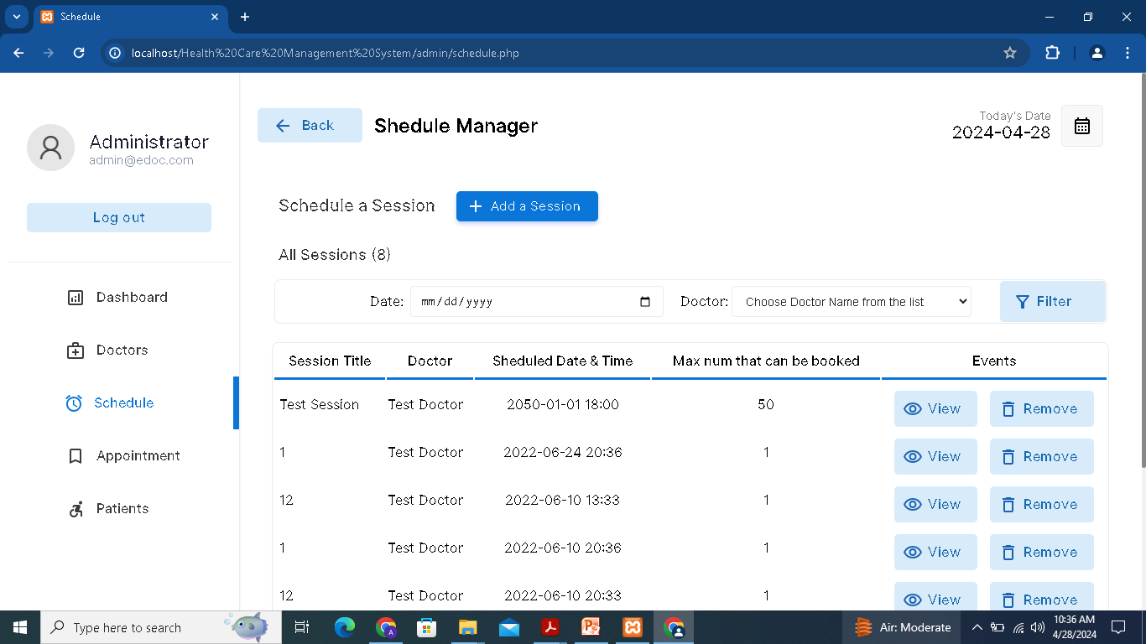
ADMIN DASHBOARD

Slide 11
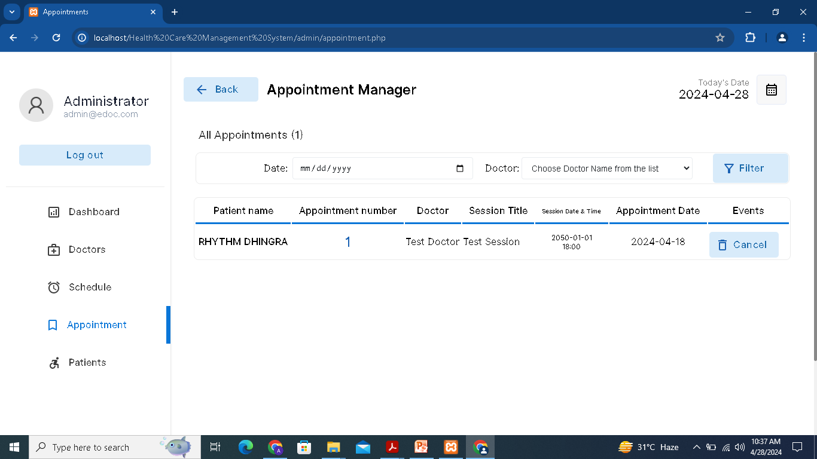
ADMIN DASHBOARD

Slide 12
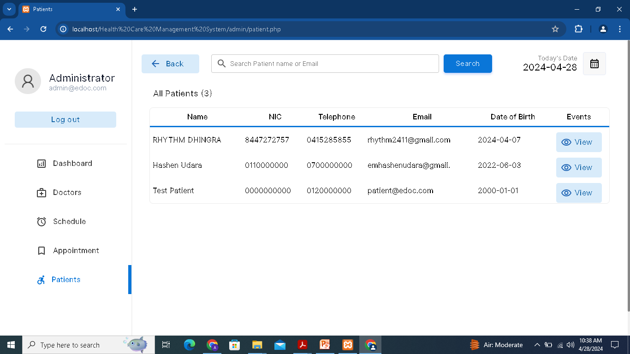
ADMIN DASHBOARD

Slide 13
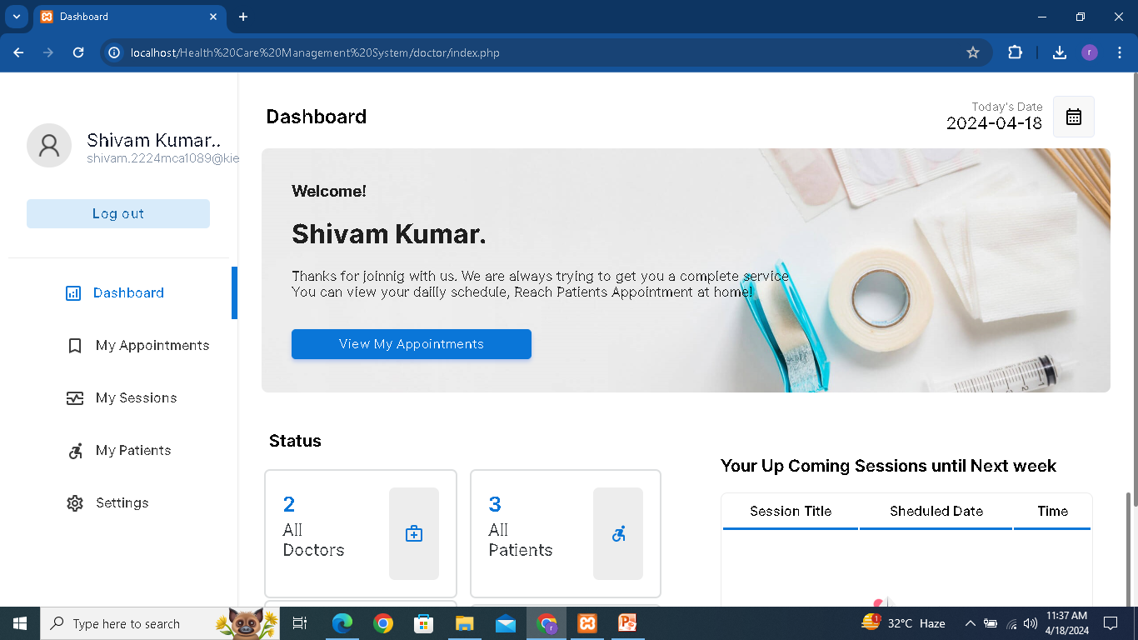
DOCTOR DASHBOARD

Slide 14
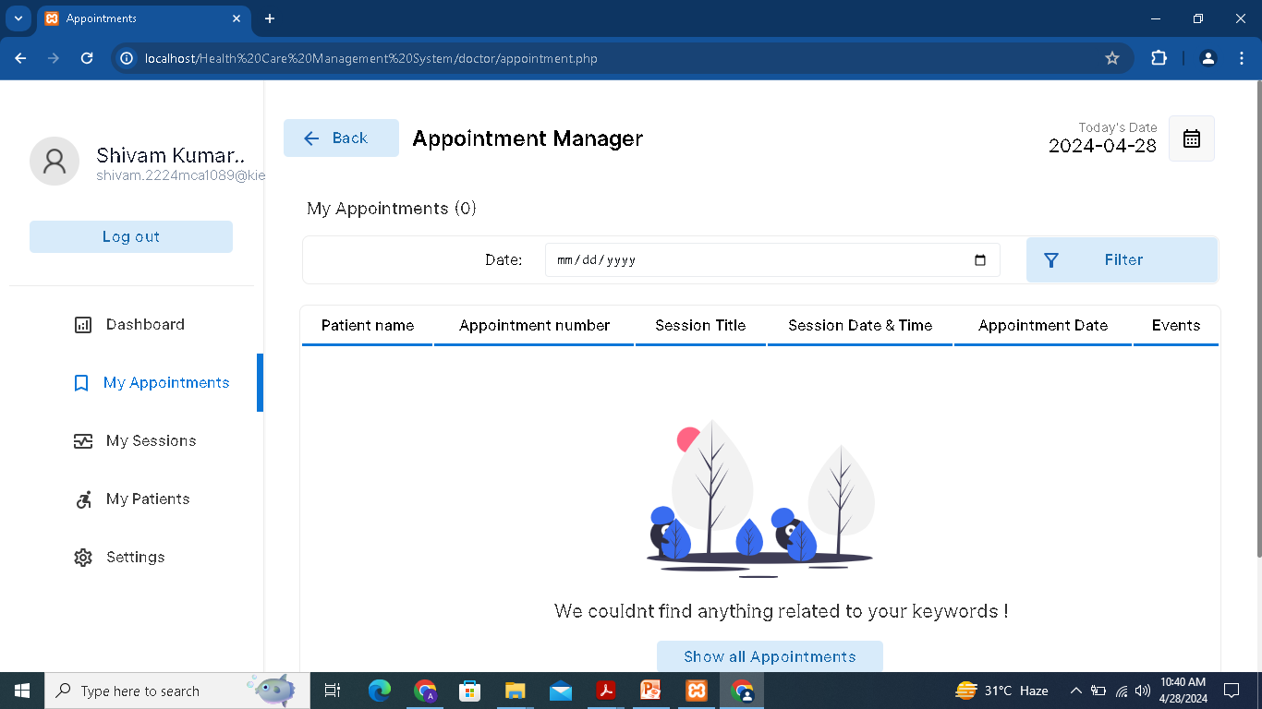
DOCTOR DASHBOARD

Slide 15
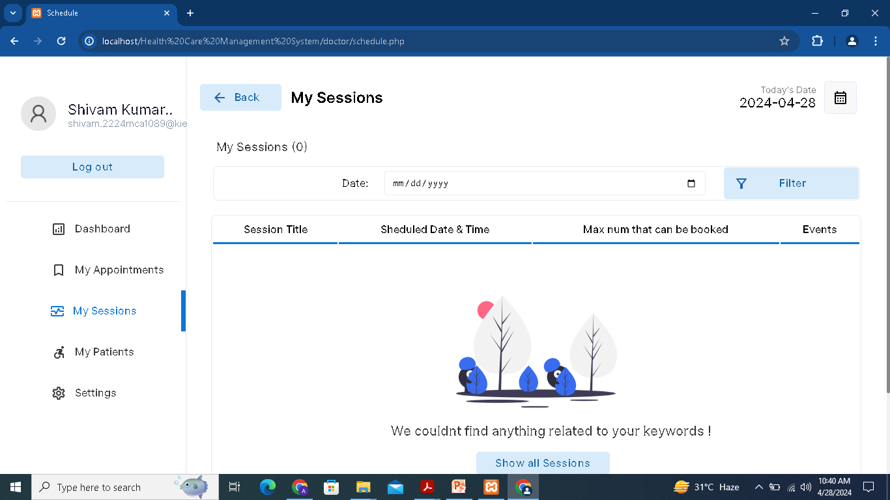
DOCTOR DASHBOARD

Slide 16
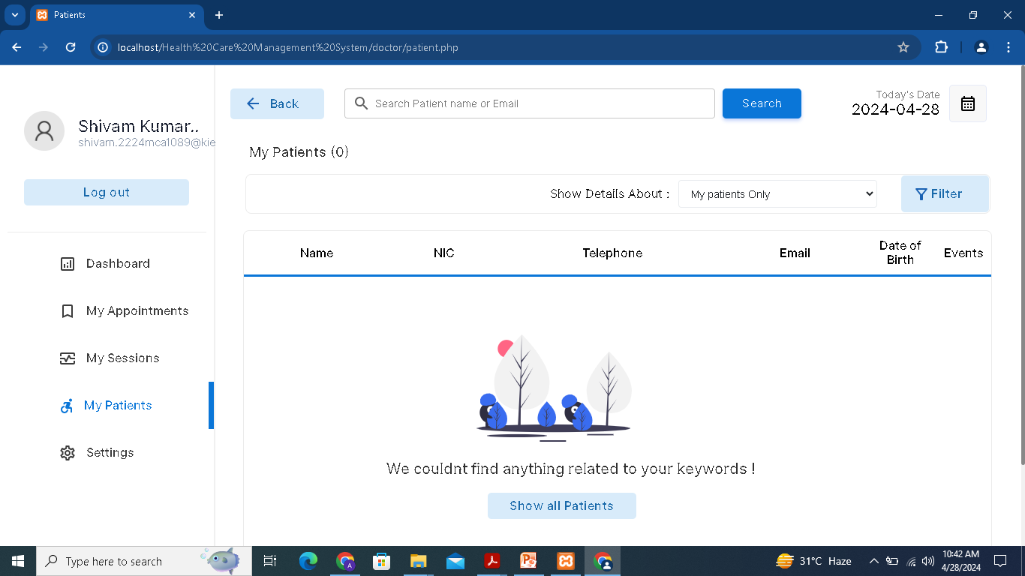
DOCTOR DASHBOARD

Slide 17
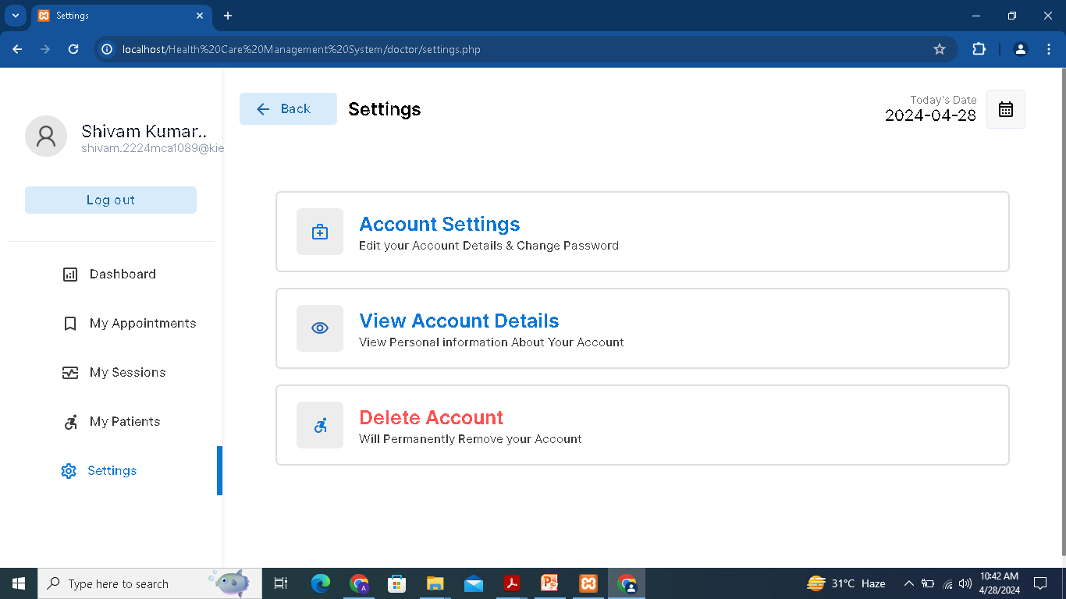
DOCTOR DASHBOARD

Slide 18
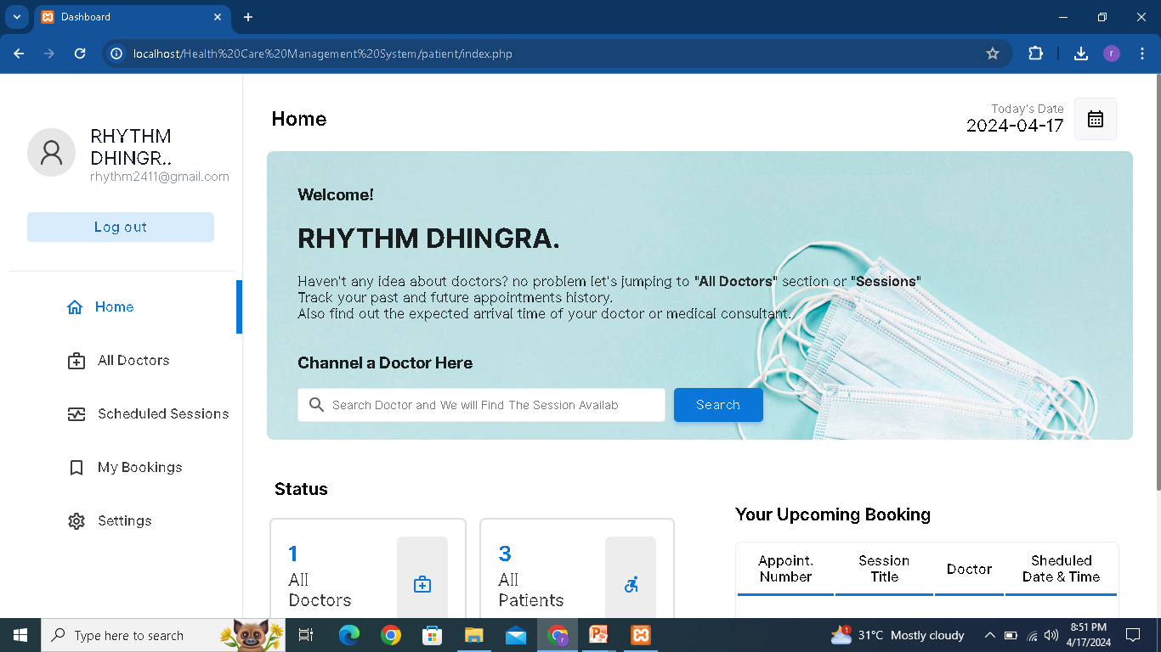
PATIENT DASHBOARD

Slide 19
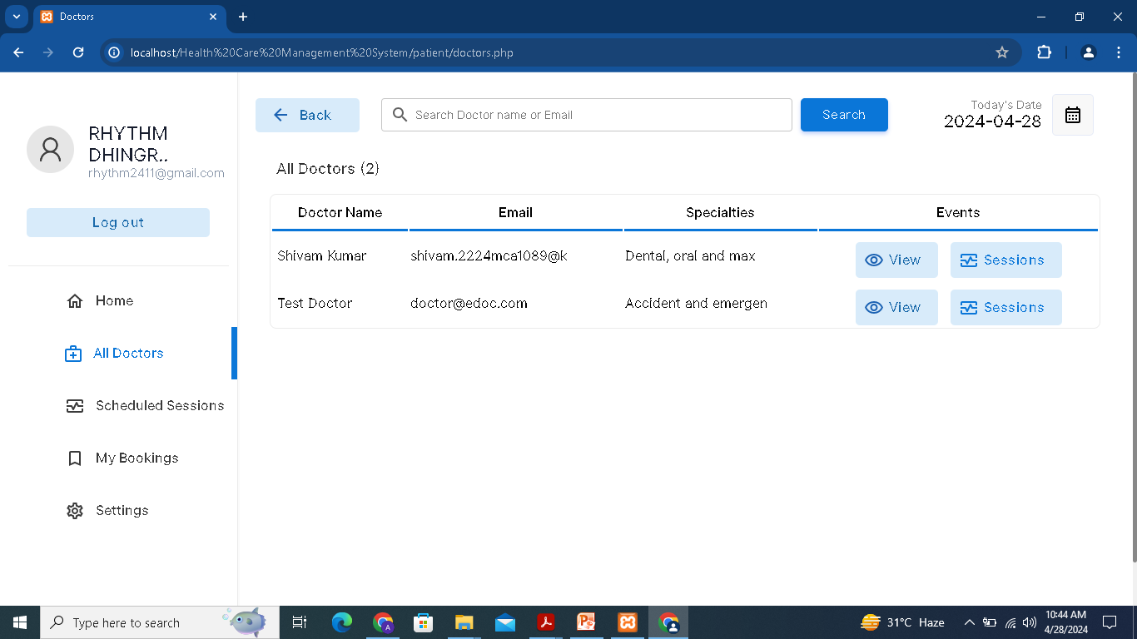
PATIENT DASHBOARD

Slide 20
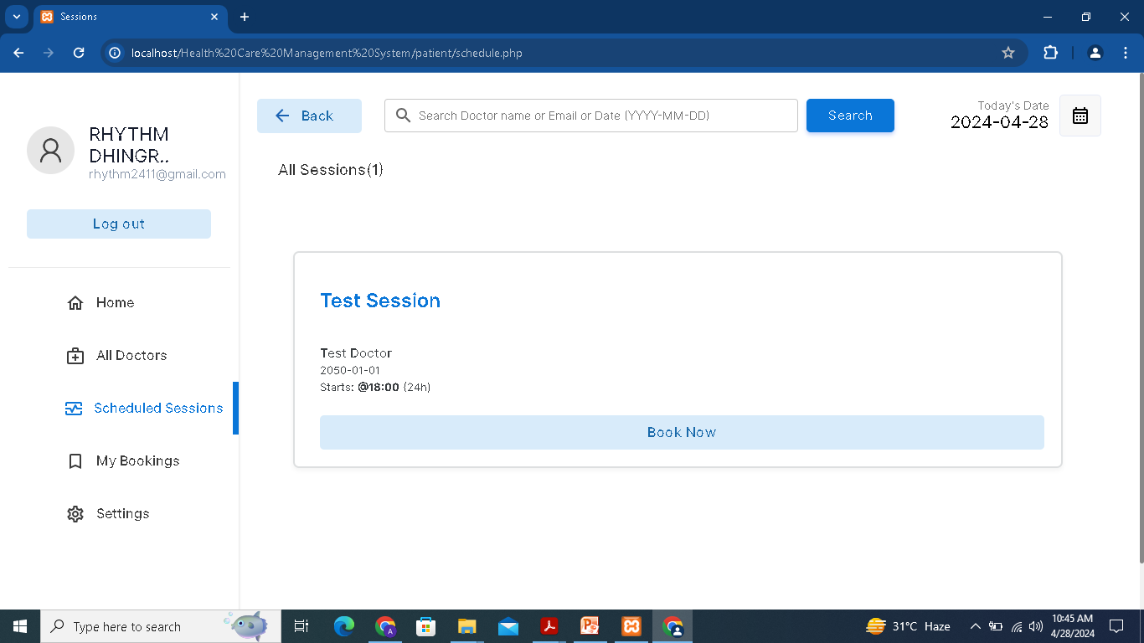
PATIENT DASHBOARD

Slide 21
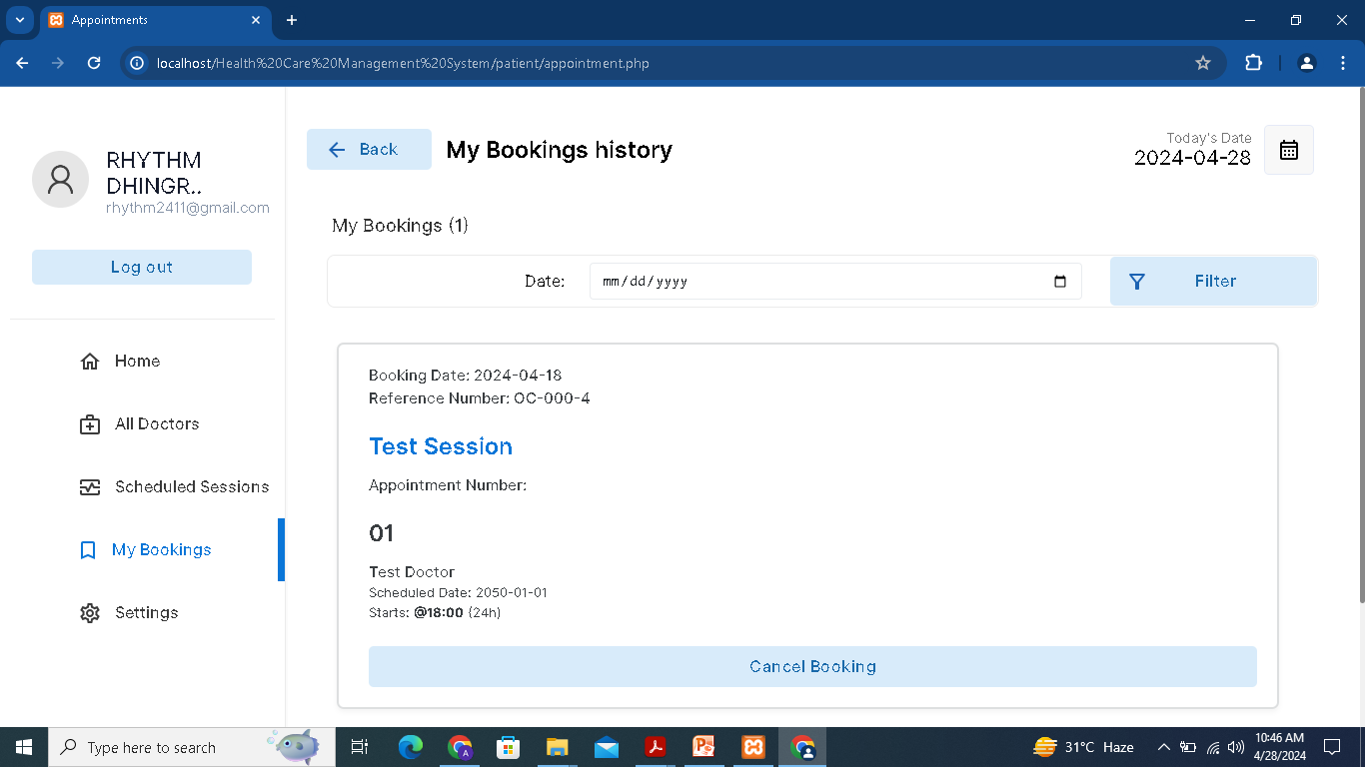
PATIENT DASHBOARD

Slide 22

PATIENT DASHBOARD

Slide 23

Thank You

